Slide 1
Outh 2.0 using Spring

Slide 2
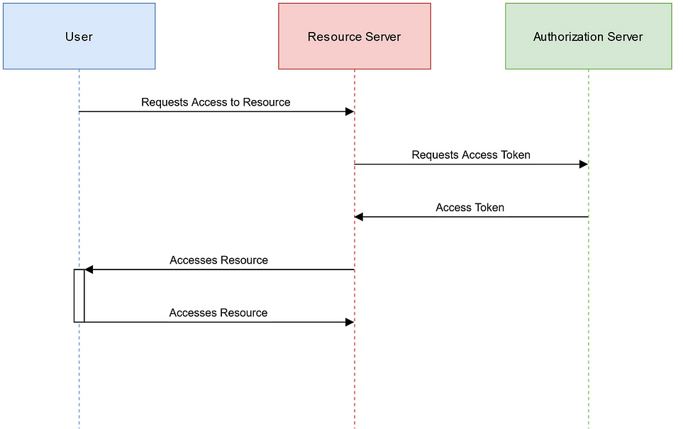
Overview
One common approach to securing microservices is by leveraging the OAuth2 protocol in conjunction with Spring Security, a powerful and widely used security framework for Java applications.
Security is also one of the main concern while designing Microservices.
We will explore the concept of securing microservices using OAuth2 and Spring Security.
We will also delve into the fundamentals of OAuth2, understand how it works with Spring Security, and explore best practices for securing microservices in a distributed environment.
So, let’s dive in and learn how to effectively secure microservices with OAuth2 and Spring Security!
Pattern 1: OpenID Connect Authentication
Create a Eureka Discovery Service
Create a Spring Cloud Gateway Application
Pattern 2: Token Relay to Service
Create a REST API Service
Route the REST API Through Spring Cloud Gateway
Pattern 3: Service-to-Service Client Credentials Grant
Create a Microservice
Secure the Micro Service using OAuth 2.0 Scopes
Update the REST API to Call the Micro Service
Putting it All Together
Learn More About Building Secure Applications

Slide 3
Pattern 1: OpenID Connect Authentication
OpenID Connect defines a mechanism for end-user authentication based on the OAuth2 authorization code flow.
In this pattern, the Authorization Server returns an Authorization Code to the application, which can then exchange it for an ID Token and an Access Token directly.
The Authorization Server authenticates the application with a ClientId and ClientSecret before the exchange happens.

Slide 4
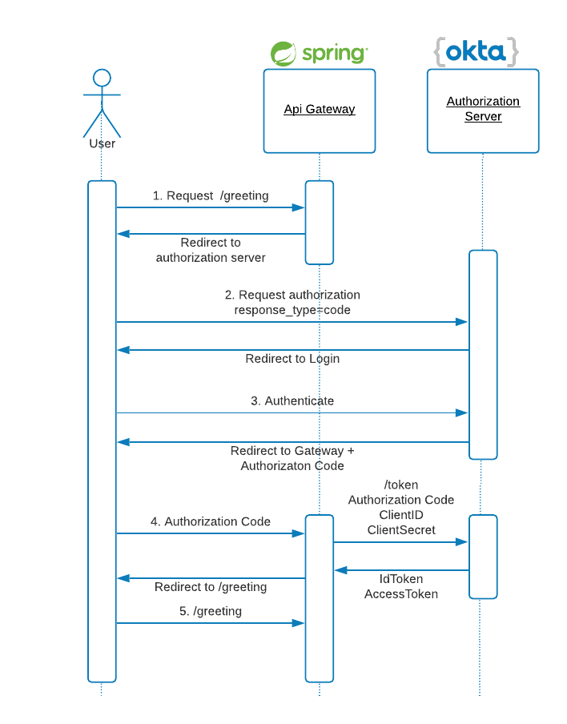
Pattern 1: OpenID Connect Authentication
As you can see in the diagram below, OpenID and OAuth2 patterns make extensive use of HTTP redirections, some of which have been omitted for clarity.
Source : https://developer.okta.com/blog/2020/08/14/spring-gateway-patterns
Notes:
For testing this OAuth2 pattern, create the API Gateway with service discovery. First, create a base folder for all the projects:
mkdir oauth2-patterns
cd oauth2-patterns

Slide 5
Pattern 1: OpenID Connect Authentication
For testing this OAuth2 pattern, create the API Gateway with service discovery.
First, create a base folder for all the projects:
mkdir oauth2-patterns
cd oauth2-patterns
Create a Eureka Discovery Service using Spring starter project
Unzip the file:
unzip eureka.zip -d eureka
cd eureka
As described in Spring Cloud Netflix documentation, the JAXB modules, which the Eureka server depends upon, were removed in JDK 11. If you are running Eureka server with JDK 11, edit the pom.xml and add the following dependency:
<dependency>
<groupId>org.glassfish.jaxb</groupId>
<artifactId>jaxb-runtime</artifactId>
</dependency>
Edit EurekaServiceApplication to add @EnableEurekaServer annotation: Refer EurekaServiceApplication class
Rename src/main/resources/application.properties to application.yml and add the following content: Refer the file
Start the service:
./mvnw spring-boot:run
Go to http://localhost:8761 and we could see the Eureka home.

Slide 6
Pattern 1: OpenID Connect Authentication
Create a Spring Cloud Gateway Application
Now let’s create an API Gateway with Spring Cloud Gateway, using Spring Initializr again.
Unzip the project
unzip api-gateway.zip -d api-gateway
cd api-gateway
Edit SpringCloudGatewayApplication to add @EnableEurekaClient annotation.
Add a package controller and the controller class src/main/java/com/okta/developer/gateway/controller/GreetingController.java. The controller will allow us to test the login without having configured any routes yet.
Add a greeting template src/main/resources/templates/greeting.html: Refer the html file
Rename src/main/resources/application.properties to application.yml and add the following properties: Refer the actual file in project
Add src/main/java/com/okta/developer/gateway/OktaOAuth2WebSecurity.java to make the API Gateway a resource server with login enabled
To keep things simple in this example, CSRF is disabled.
Before we begin, you’ll need a free Okta developer account. Install the Okta CLI and run okta register to sign up for a new account. If you already have an account, run okta login. Then, run okta apps create. Select the default app name, or change it as you see fit. Choose Web and press Enter.
Select Okta Spring Boot Starter. Accept the default Redirect URI values provided for you.
That is, a Login Redirect of http://localhost:8080/login/oauth2/code/okta and a Logout Redirect of http://localhost:8080
Notes:
To keep things simple in this example, CSRF is disabled.
Now we need to create an authorization client in Okta. Log in to your Okta Developer account (or sign up if you don’t have an account).
From the Applications page, choose Add Application.
On the Create New Application page, select Web.
Name your app Api Gateway, add http://localhost:8080/login/oauth2/code/okta as a Login redirect URI, select Refresh Token (in addition to Authorization Code), and click Done.
Copy the issuer (found under API > Authorization Servers), client ID, and client secret.
Start the gateway with:
Shell
1
OKTA_OAUTH2_ISSUER={yourOktaIssuer} \
2
OKTA_OAUTH2_CLIENT_ID={yourOktaClientId} \
3
OKTA_OAUTH2_CLIENT_SECRET={yourOktaClientSecret} \
4
./mvnw spring-boot:run
Go to http://localhost:8080/greeting. The gateway will redirect to Okta login page:

Slide 7
Pattern 1: OpenID Connect Authentication
What does the Okta CLI do?
The Okta CLI will create an OIDC Web App in your Okta Org. It will add the redirect URIs you specified and grant access to the Everyone group. You will see output like the following when it’s finished:
Okta application configuration has been written to:
/path/to/app/src/main/resources/application.properties
Open src/main/resources/application.properties to see the issuer and credentials for your app.
okta.oauth2.issuer=https://dev-133337.okta.com/oauth2/default
okta.oauth2.client-id=0oab8eb55Kb9jdMIr5d6
okta.oauth2.client-secret=NEVER-SHOW-SECRETS
NOTE: We can also use the Okta Admin Console to create our app
Use the issuer, client ID, and client secret from the generated .okta.env file to start the gateway:
OKTA_OAUTH2_ISSUER={yourOktaIssuer} \
OKTA_OAUTH2_CLIENT_ID={yourOktaClientId} \
OKTA_OAUTH2_CLIENT_SECRET={yourOktaClientSecret} \
./mvnw spring-boot:run
Notes:
https://developer.okta.com/docs/guides/sign-into-web-app-redirect/spring-boot/main/

Slide 8
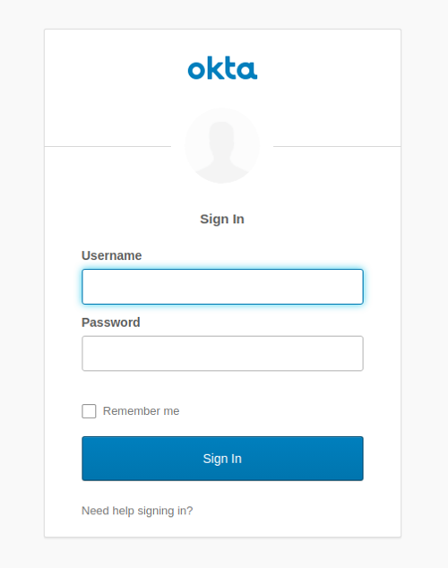
Pattern 1: OpenID Connect Authentication
Go to http://localhost:8080/greeting.
The gateway will redirect to Okta login page:
After the login, the idToken and accessToken will be displayed in the browser.
idToken: eyJraWQiOiIw...
accessToken: eyJraWQiOi...
Notes:
https://developer.okta.com/docs/guides/sign-into-web-app-redirect/spring-boot/main/

Slide 9
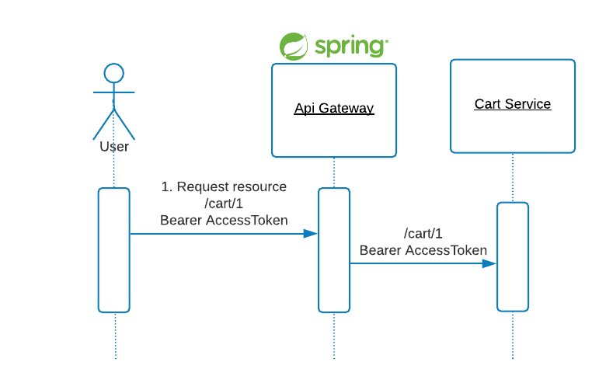
Pattern 2: Token Relay To Service
A Token Relay happens when an OAuth2 consumer, for example the API Gateway, acts as a Client and forwards the accessToken to the routed service.

Slide 10
Pattern 2: Token Relay To Service
Create a REST API Service
Let’s create a shopping cart service using Spring initializer
Download cart-service.zip
Unzip the file:
unzip cart-service.zip -d cart-service
cd cart-service
Edit pom.xml and add Jackson Datatype Money dependency. For this tutorial, we will use JavaMoney for currency.
<dependency>
<groupId>org.zalando</groupId>
<artifactId>jackson-datatype-money</artifactId>
<version>1.1.1</version>
</dependency>

Slide 11
Pattern 2: Token Relay To Service
Before creating the entities for the service, add a MonetaryAmountConverter for mapping the MonetaryAmount type to the database. The conversion to and from BigDecimal for persistence allows using the built-in Hibernate BigDecimal to JDBC numeric mapping. Add src/main/java/com/okta/developer/cartservice/model/
MonetaryAmountConverter.java: refer the file in project
Create the Cart and LineItem model classes under src/main/java/com/okta/developer/cartservice/model package: Refer the file in the project
Add a CartRepository under src/main/java/com/okta/developer/cartservice/repository/CartRepository.java : Refer the file in the project
Create the CartNotFoundException under src/main/java/com/okta/developer/cartservice/controller/CartNotFoundException.java for mapping the API 404 in the CartController we will create after: Refer the file in the project
Add a CartController under src/main/java/com/okta/developer/cartservice/controller/CartController.java: Refer project
Configure the Jackson Money Datatype module. Add a WebConfig class under src/main/java/com/okta/developer/cartservice Refer project
Edit CartServiceApplication and add @EnableEurekaClient
Rename src/main/resources/application.propeties to application.yml and add the following values
Start the service

Slide 12
Pattern 2: Token Relay To Service
Route the REST API Through Spring Cloud Gateway
Go to the api-gateway project and add a route for the cart service, edit SpringCloudGatewayApplication
@Bean
public RouteLocator routeLocator(RouteLocatorBuilder builder, TokenRelayGatewayFilterFactory filterFactory) {
return builder.routes()
.route("cart", r -> r.path("/cart/**")
.filters(f -> f.filter(filterFactory.apply()))
.uri("lb://cart"))
.build();
}
TokenRelayGatewayFilterFactory will find the accessToken from the registered OAuth2 client and include it in the outbound cart request.
Restart the gateway with:
OKTA_OAUTH2_ISSUER={yourOktaIssuer} \
OKTA_OAUTH2_CLIENT_ID={clientId} \
OKTA_OAUTH2_CLIENT_SECRET={clientSecret} \
./mvnw spring-boot:run
Go to http://localhost:8080/greeting and copy the accessToken. Then use the accessToken to make requests to the cart API through the gateway.

Slide 13
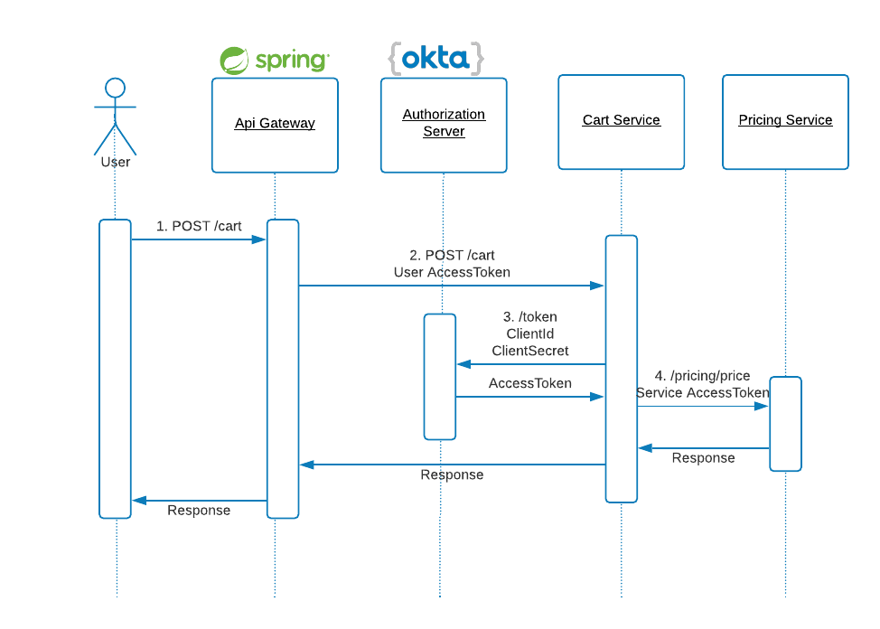
Pattern 3: Service-to-Service Client Credentials Grant
In this authorization pattern, the application requests an access token using only its own client credentials.
This flow is suitable for machine-to-machine (M2M) or service-to-service authorizations.

Slide 14
Pattern 3: Service-to-Service Client Credentials Grant
Create a Microservice
For service-to-service authorization, create a pricing Spring Boot service with Spring Initializr
pricing-service
Edit pom.xml and add Jackson Datatype Money dependency again.
<dependency>
<groupId>org.zalando</groupId>
<artifactId>jackson-datatype-money</artifactId>
<version>1.1.1</version>
</dependency>
Create the src/main/java/com/okta/developer/pricing/model/Cart.java and src/main/java/com/okta/developer/pricing/model/LineItem.java model classes
Create the src/main/java/com/okta/developer/pricing/service/PricingService.java interface and a src/main/java/com/okta/developer/pricing/service/DefaultPricingService implementation to calculate prices for the LineItem
Create a PricingController to handle the pricing request. Add the class src/main/java/com/okta/developer/pricing/controller/PricingController.java
Configure the Jackson Money Module in a src/main/java/com/okta/developer/pricing/WebConfig.java class

Slide 15
Pattern 3: Service-to-Service Client Credentials Grant
Secure the Micro Service Using OAuth 2.0 Scopes
Protect the pricing endpoint by requiring a custom scope pricing in the accessToken.
One way to do it is with HttpSecurity configuration.
Add a src/main/java/com/okta/developer/pricing/WebSecurity.java class with the following : Refer project
Add @EnableEurekaClient to PricingServiceApplication
Rename src/main/resources/application.properties to application.yml and add the following: Refer project
Start the service
Let’s try the pricing API without an accessToken
http://localhost:8082/pricing/price
With the -v verbose flag, you should see the request is rejected with 401 (Unauthorized)

Slide 16
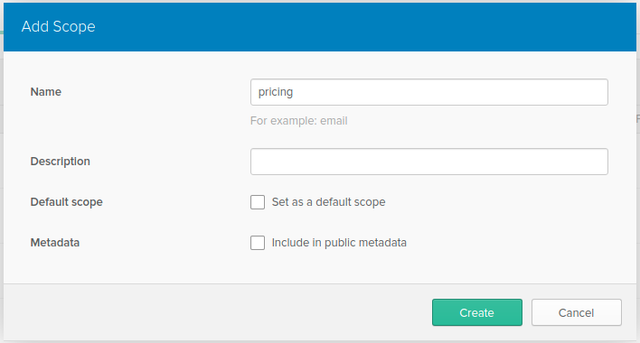
Pattern 3: Service-to-Service Client Credentials Grant
Update the REST API to Call the Microservice
Now we are going to configure cart-service to use the client credentials grant flow to request pricing.
First create a new authorization client in Okta.
From the Applications page, choose Add Application
On the Create New Application page, select Service
Name your app Cart Service and click Done
Copy the new client ID, and client secret.
Create a custom scope to restrict what the cart-service accessToken can access.
From the menu bar select API -> Authorization Servers. Edit the authorization server by clicking on the edit pencil, then click Scopes -> Add Scope.
Fill out the name field with pricing and press Create.

Slide 17
Pattern 3: Service-to-Service Client Credentials Grant
We need to configure the OAuth2 client in the cart-service application, for calling the pricing-service.
OAuth2RestTemplate is not available in Spring Security 5.3.x.
According to Spring Security OAuth migration guides, the way to do this is by using RestTemplate interceptors or WebClient exchange filter functions.
Since Spring 5, RestTemplate is in maintenance mode, using WebClient (which supports sync, async, and streaming scenarios) is the suggested approach. So let’s configure a WebClient for the pricing call.
First, add the spring-webflux starter dependency to the cart-service pom.xml
<dependency>
<groupId>org.springframework.boot</groupId>
<artifactId>spring-boot-starter-webflux</artifactId>
</dependency>
IMPORTANT: Adding both spring-boot-starter-web and spring-boot-starter-webflux modules results in Spring Boot auto-configuring Spring MVC, not WebFlux. This allows Spring MVC applications to use the reactive WebClient.

Slide 18
Pattern 3: Service-to-Service Client Credentials Grant
Create src/main/java/com/okta/developer/cartservice/WebClientConfig.java
In the code above, we set a custom json decoder, from the objectMapper that includes the MoneyModule, so the monetary amounts are correctly serialized and deserialized. Also, we set pricing-client as the default OAuth 2.0 registrationId.
For service discovery, a ReactorLoadBalancerExchangeFilterFunction must be added to the WebClient.
Let’s now configure the OAuth 2.0 client registration. Edit the cart-service application.yml and add security.oauth2 properties. The cart-service is a resource server and an OAuth 2.0 client at the same time.
Note the Ribbon load balancer has been disabled, otherwise the ReactorLoadBalancer auto-configuration will fail.
Also, note the requested scope for the client_credentials grant is pricing, the custom scope. Then, the accessTokens for this client will only have access to the pricing-service. Adding a custom scope for the client_credentials flow is a best practice.
Spring Boot will auto-configure the application as an OAuth2 client because of the client.registration presence in the YAML. Add a src/main/java/com/okta/developer/cartservice/WebSecurity.java class to override the auto-configuration, and configure the application as an OAuth 2.0 resource server
Create the class src/main/java/com/okta/developer/cartservice/service/PricingException.java to return HttpStatus.INTERNAL_SERVER_ERROR (HTTP status 500) when the cart cannot be priced due to an unexpected error
Add a PricingService for the pricing implementation. Create the class src/main/java/com/okta/developer/cartservice/service/PricingService.java
Note that the ‘WebClient’ is making a synchronous call, as we invoke response.block() to get the pricing result. This is the expected approach for non-reactive applications.
Modify the CartController to request pricing when creating a cart

Slide 19
Pattern 3: Service-to-Service Client Credentials Grant
Restart the cart-service
Putting it All Together
Create a cart through the API Gateway again, make sure to have a valid accessToken from http://localhost:8080/greeting
You should get a priced cart as response
Take a look at the System Log in the Okta Dashboard and you will see an entry indicating the Cart Service requested an access token

Slide 20
Reference:
https://developer.okta.com/blog/2020/08/14/spring-gateway-patterns
https://developer.okta.com/signup/
https://developer.okta.com/docs/guides/sign-into-web-app-redirect/spring-boot/main/

